Slide 1
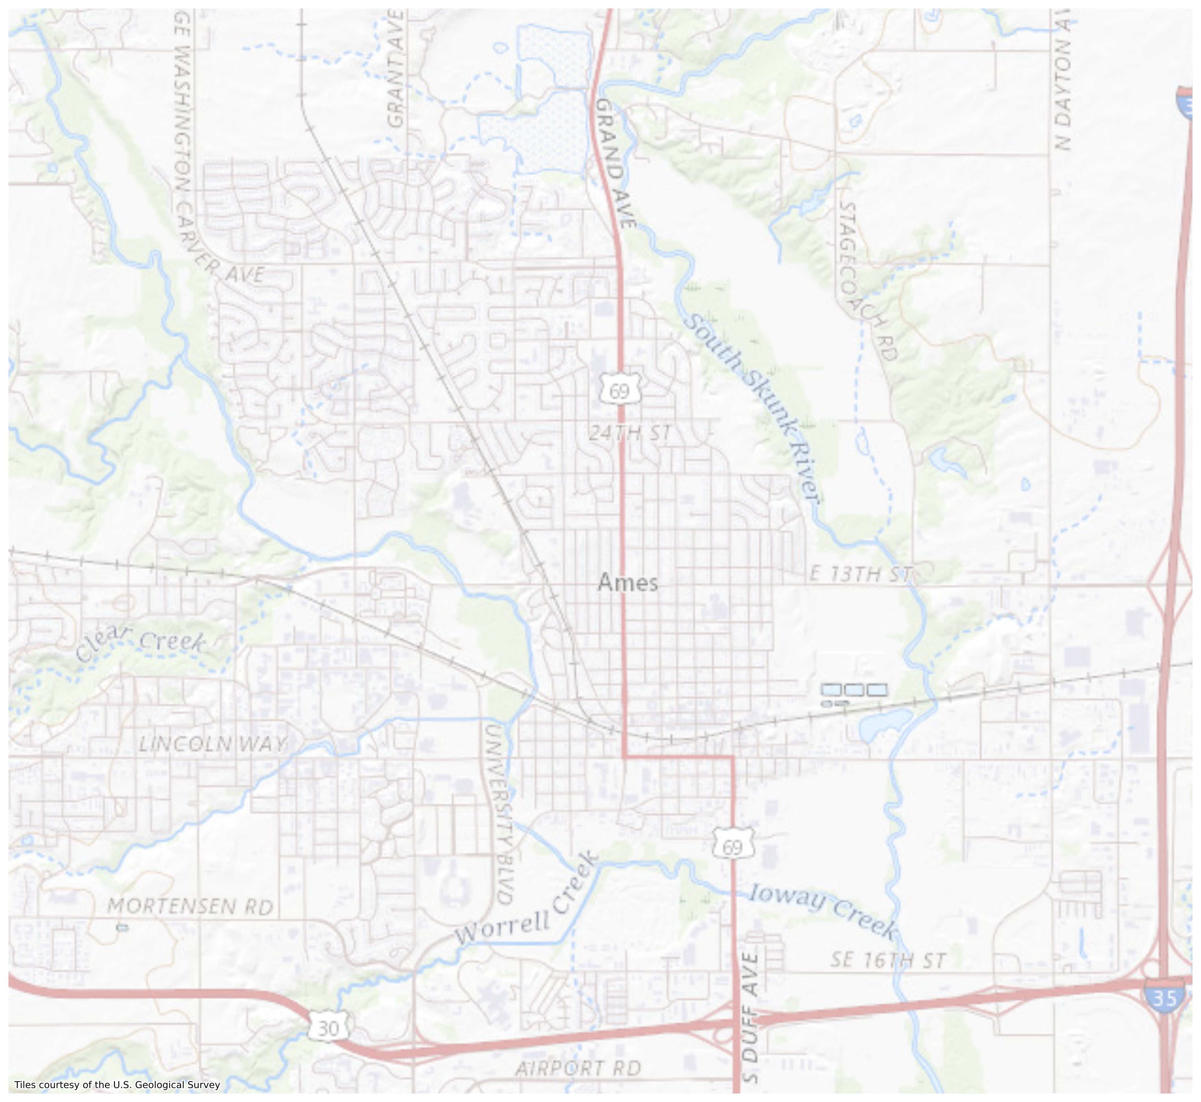
Pandemic Effects in the Ames Housing Market 2019 vs. 2021
Leland Murrin

Slide 2
Introduction
Who we are:
An independent consulting group for real estate firms operating in Ames, Iowa
Our focus:
People moving from a larger city to a smaller town like Ames to save on housing costs and who may work remotely
Client main concerns:
How close is the house to desired services (e.g., gyms, spas, organic groceries, hospitals, etc.)?
How do specific house features affect the sale price?
Real estate firm concerns:
How did the housing market change due to the pandemic (i.e., 2019 vs 2021 data)?
How does the proximity to given services impact sale price?
What neighborhoods would this particular client group prefer?

Slide 3
Background
City of Ames:
Population: ~66,424 people (From 2021 Census)
Area: 27.92 mi²
Largest employer: Iowa State University
Location: ~37 miles north of Des Moines, Iowa
Pandemic Migration:
Pandemic migration saw remote workers migrating from very large cities to smaller cities like Ames
Anecdotal evidence suggests that those moving from a major city might still require the convenience of services they relied on
Sources: Governing.com, New York Times
Data:
The data was sourced from the Ames City Assessor website that archives recent home sales up to 2021
For data cleaning, undeveloped lots, houses built after the sale date, or houses where the year built is equal to 0 were excluded from analysis
Only house sales from 2019 and 2021 were considered

Slide 4
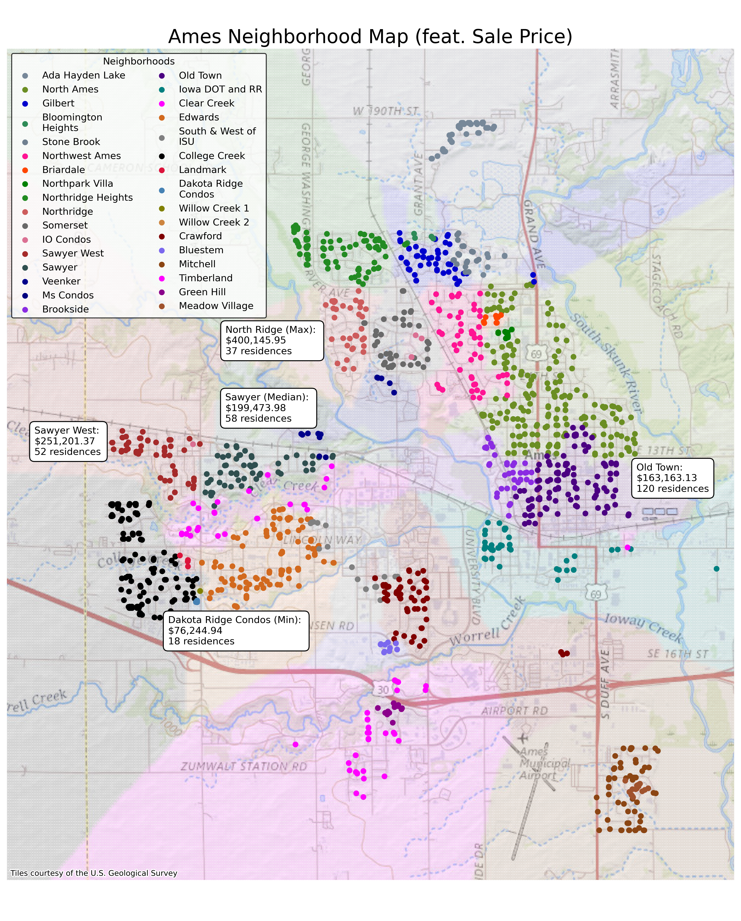
House Sales 2019&2021
Neighborhoods:
33 neighborhoods listed in the dataset
Condos are found in subsections of neighborhoods (e.g., Dakota Ridge)
Open space in city center due to land owned by Iowa State University
Old Town considered the downtown area of the city
Sale Price:
Selected neighborhoods highlighted as an example of the full distribution of the sale prices for homes
Condos generally have the lowest sale prices
Highest sale prices found in northern and western parts of city

Slide 5
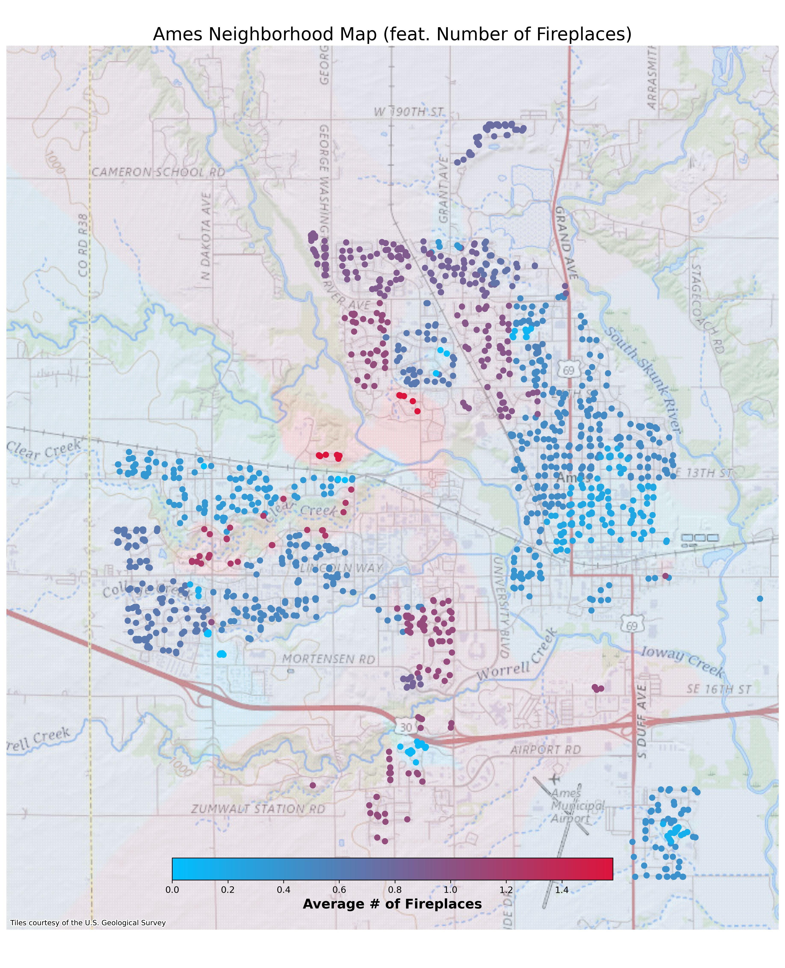
House Sales 2019&2021
Fireplaces:
Number of fireplaces within each household
Map shows average number of fireplaces per home per neighborhood
Old Town and condos have least number of fireplaces on average per home
Residences and neighborhoods with highest average sale prices generally have more fireplaces (e.g., North Ridge, Veenker, and North Ridge Heights)

Slide 6
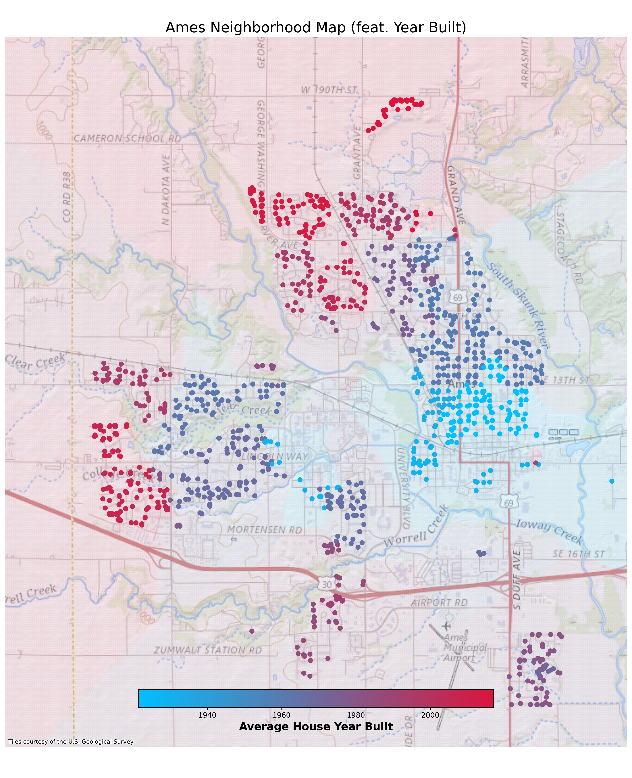
House Sales 2019&2021
Year Built:
Oldest houses sold built in the 1880s (Old Town and S&W of ISU)
Newest houses sold built in 2020 (Far north and west suburbs of town)
General trend: further from Old Town, the newer the house
Neighborhoods with newer houses generally have a higher average sale price

Slide 7
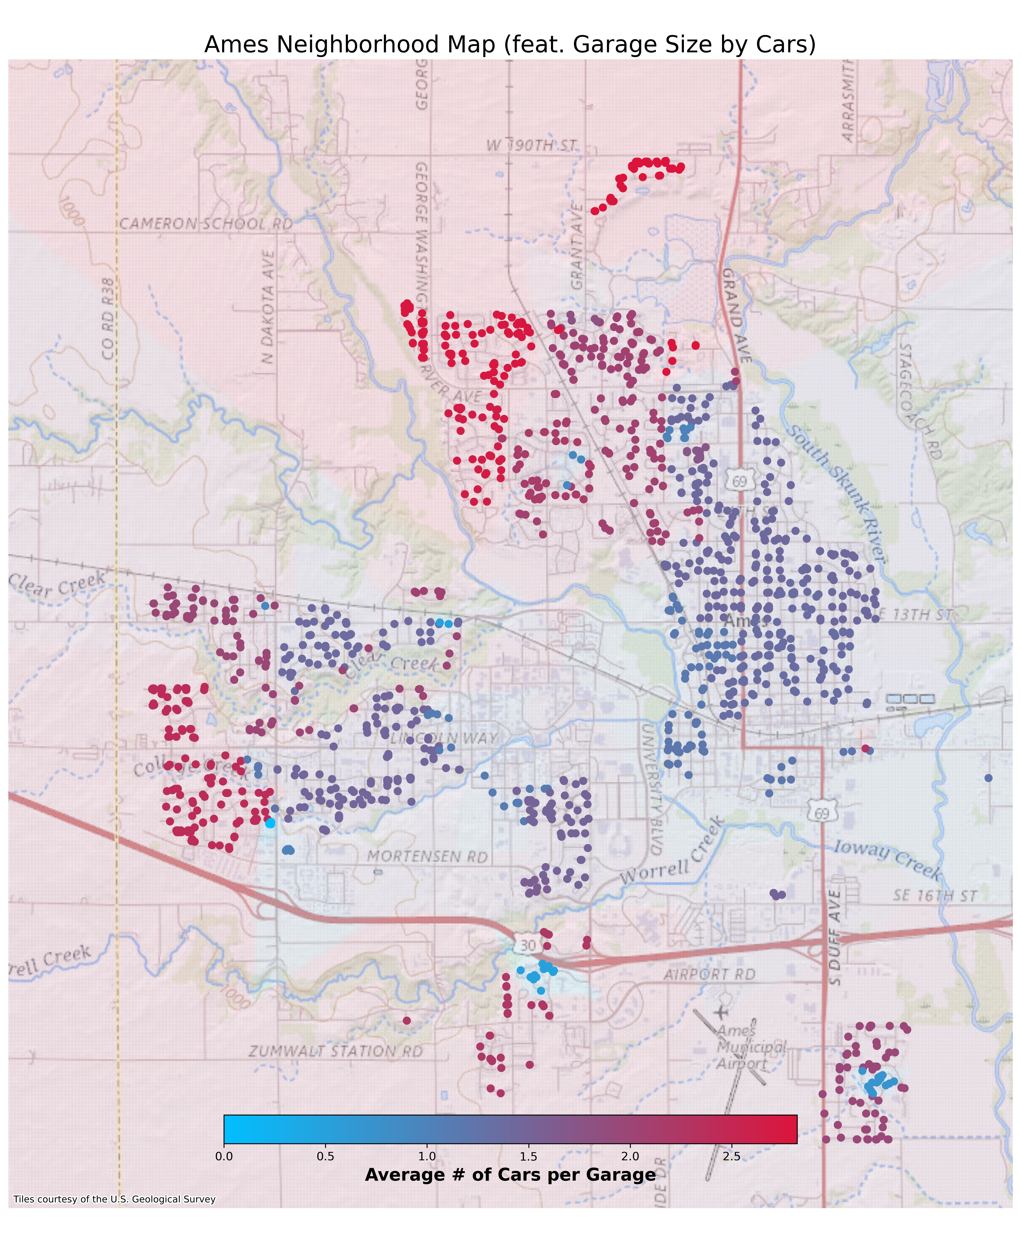
House Sales 2019&2021
Garage size by car capacity:
Neighborhoods with higher garage capacity are generally found in the North and West of Ames (e.g., North Ridge, North Ridge Heights and College Creek)
Due to the distance from the center of town, it is reasonable to assume that houses on the outskirts of town require more cars
Neighborhoods with higher garage capacity generally have a higher average sale price

Slide 8
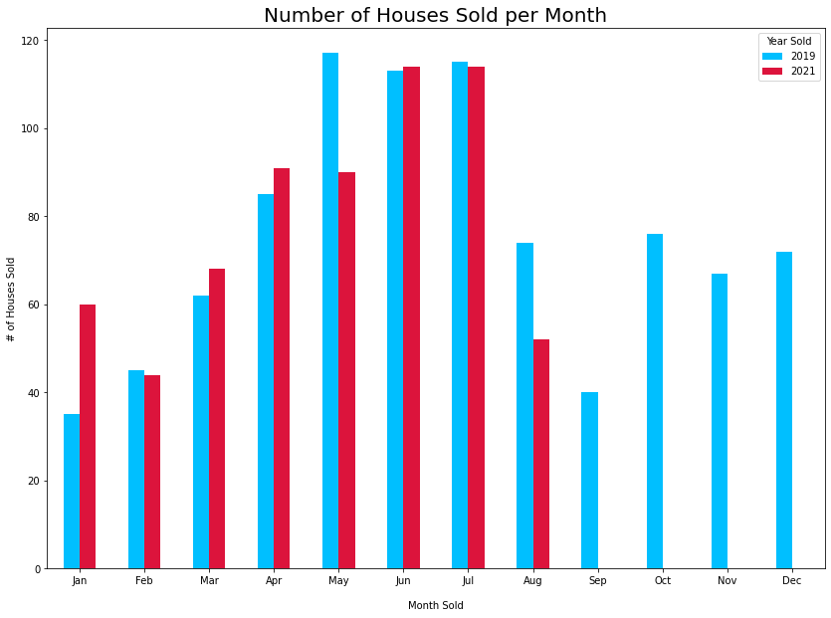
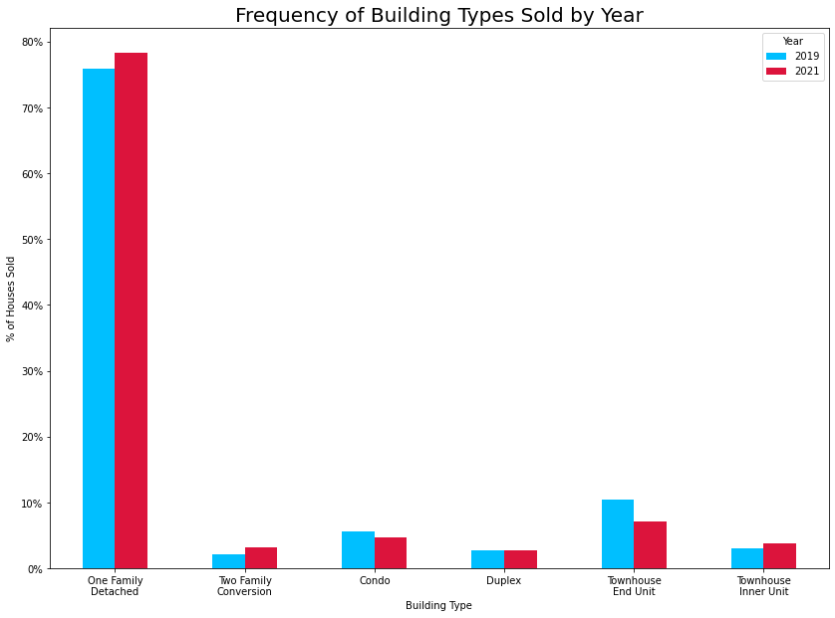
House Sales 2019&2021
866 houses sold throughout the year 2019; 611 houses sold through august in year 2021
House sales per month differed across both years (chi² p-value = 0.046)
2021 shows more even distribution of sales throughout the year compared to 2019
Dominant building type for both years was one family detached houses

Slide 9
See Part 2
(Slides 9-28)

